Slide 1
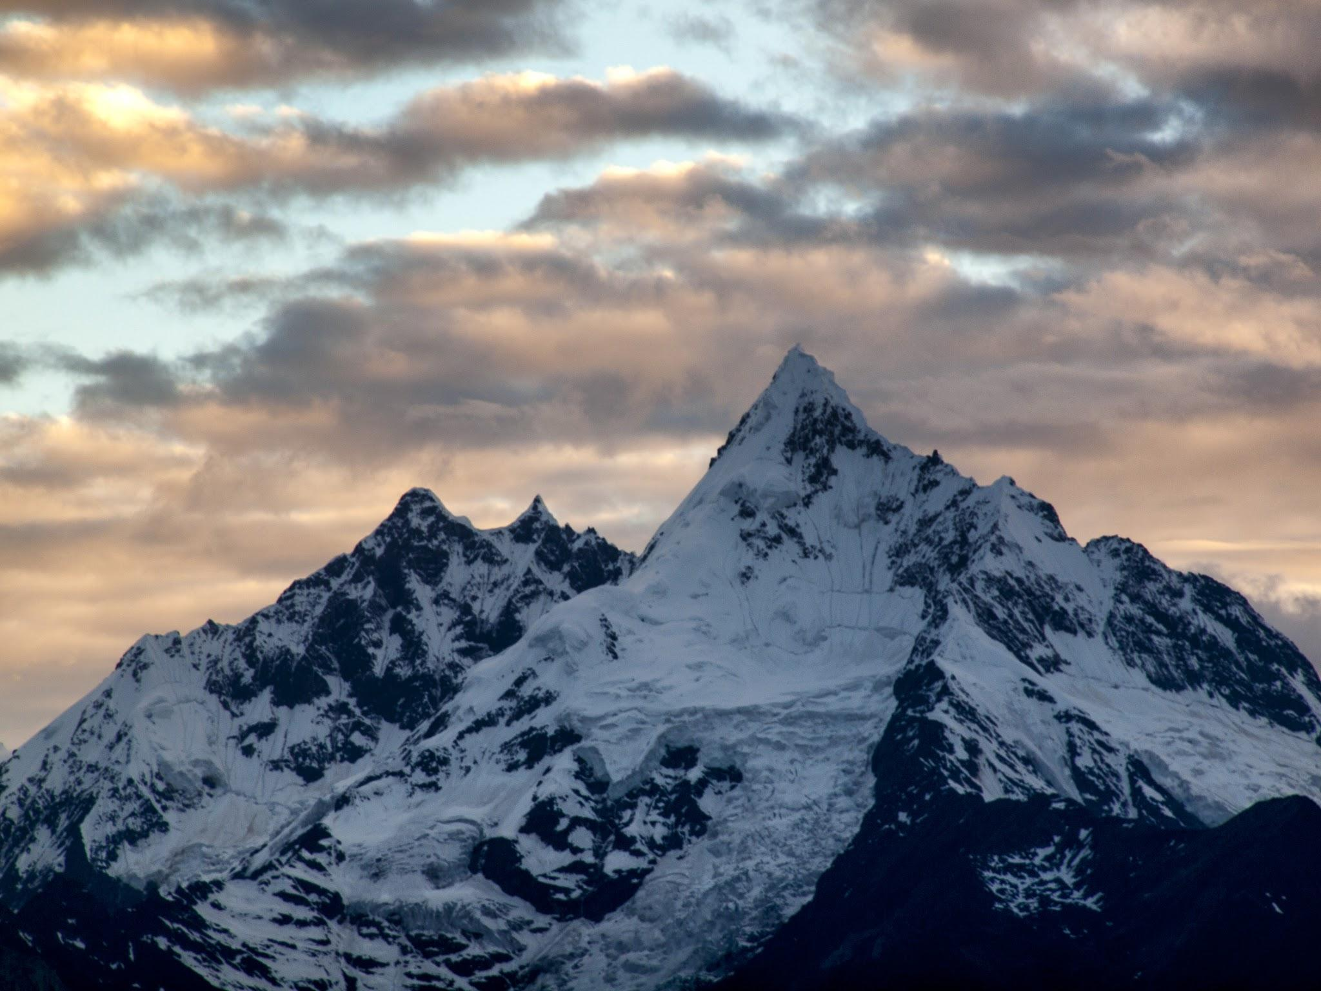
Big Mountain Resort Pricing Strategy

Slide 2
01
Problem Statement
02
Recommendation and Key Findings
TABLE OF CONTENTS
03
Modeling results and analysis
04
Summary and conclusion

Slide 3
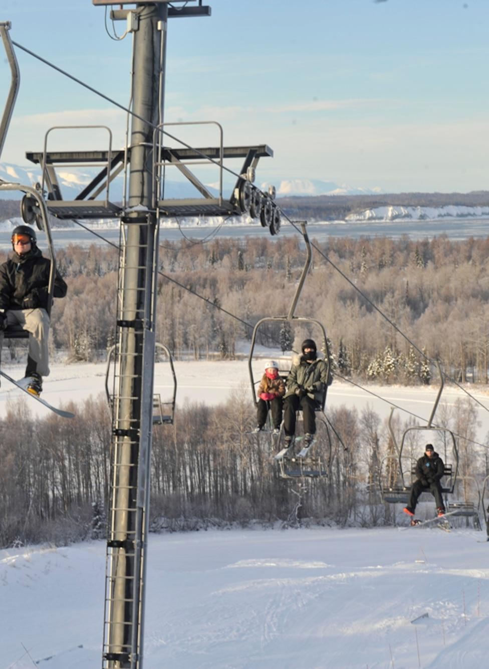
Problem Statement
01
Big Mountain Resort has recently added an additional chair lift, which has led to an increase in operating costs by $1,5M annually. The resort's current pricing is set above the average market rate but lacks insight on the diverse amenities' performance and unable to capture full potential of profitability.
Big Mountain Resort wants to ensure ticket prices are competitive while maximizing revenue. We need to understand how our prices compare to other resorts given our facilities and amenities and discover opportunity to optimize pricing and investments based on data-driven insights.

Slide 4
Recommendation:
Increase weekend ticket price by 15% from $81 to $93
02
Underpriced
Cost Reduction
New Investment
Key Findings:
Big Mountain's facilities support a ticket price of $93:
Currently underpriced by 15% compared to other US ski resorts
Big Mountain can close up to 5 underutilized runs with minimal impact:
Reduce operational cost with low impact on ticket price and revenue
Big Mountain should invest in new lift to increase vertical drop by 150 ft:
Supports additional $0.54 price increase
$1M in additional annual revenue

Slide 5
Modeling results and analysis
03
Modeling Approach
Collected data on ticket prices and resort characteristics for over 300 ski resorts
Built a Random Forest model to predict ticket prices based on resort facilities and amenities
Evaluated model using 5-fold cross validation
Used model to identify pricing opportunities and evaluate investment scenarios
Model Performance
MAE of $10.28 on training data
MAE of $9.02 on test data
Model accurately predicts ticket prices based on resort characteristics

Slide 6
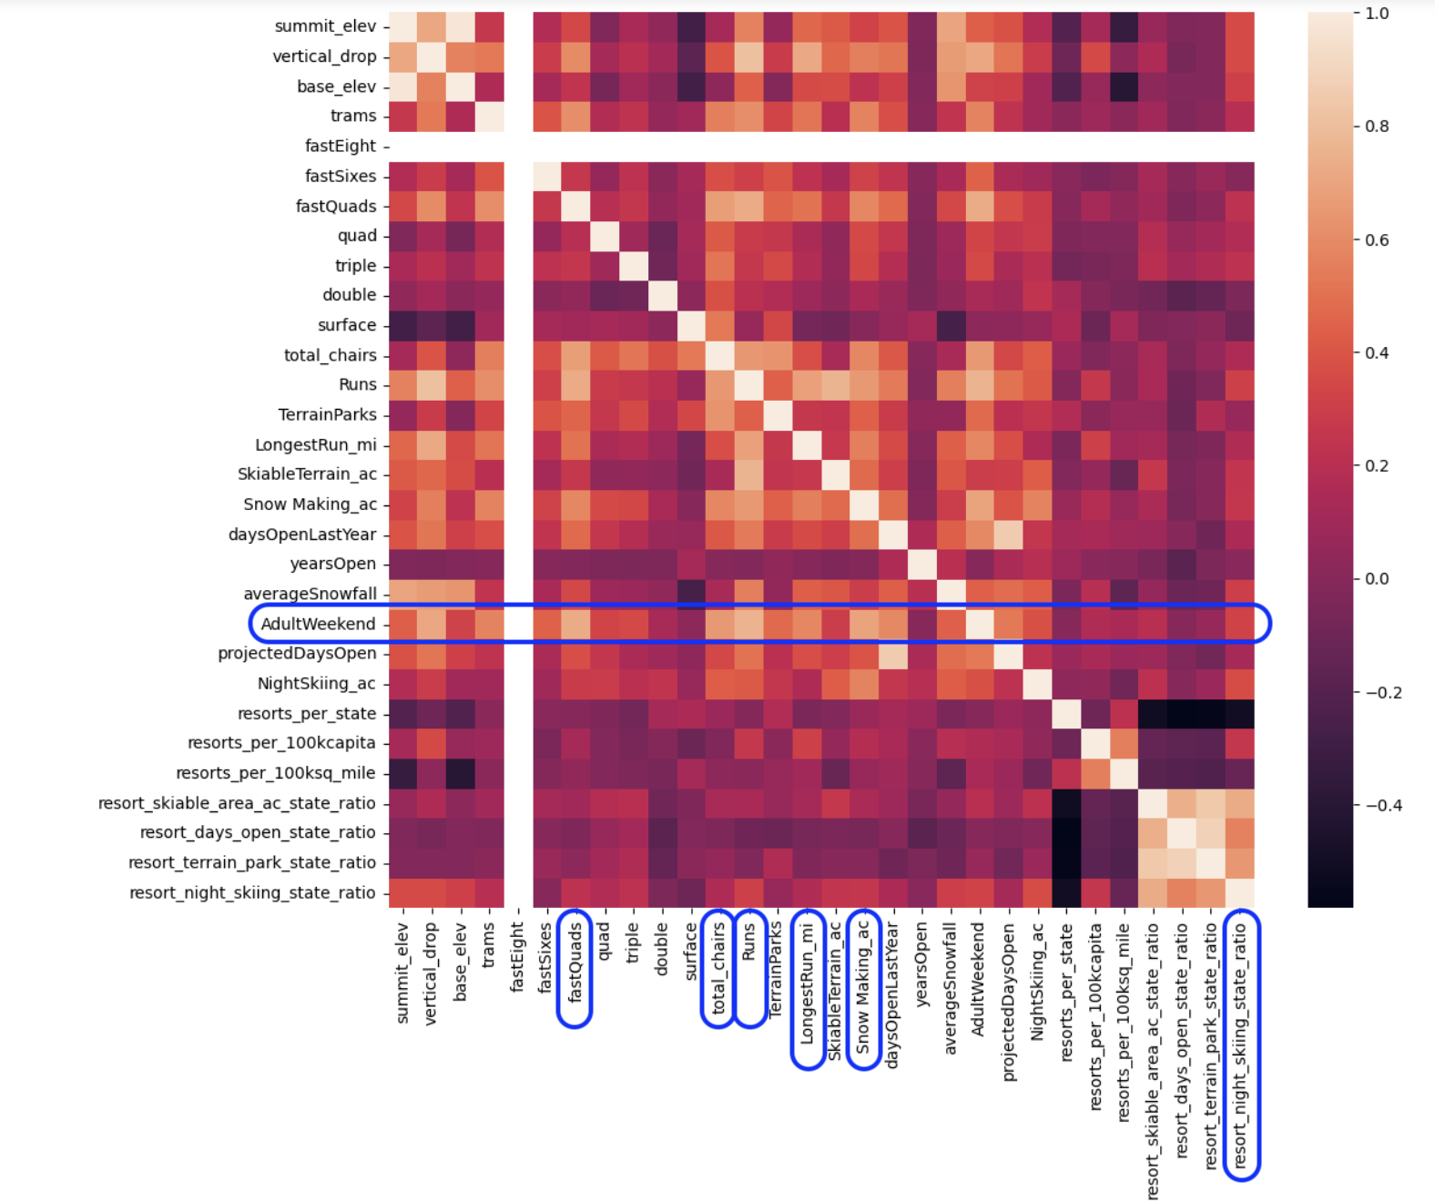
Modeling results and analysis (contd.)
Key Price Drivers
Most important features driving price:
Number of fast quad and chairs
Total number of runs
Acres of snowmaking coverage
Acres of Night skiing area

Slide 7
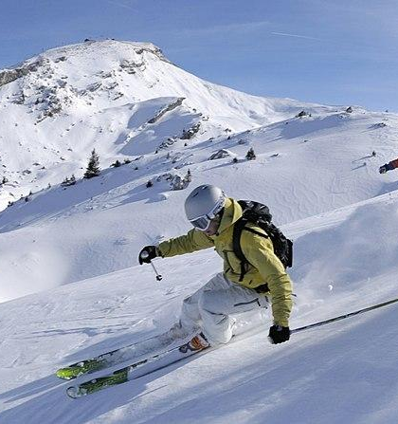
Summary
04
Big Mountain's facilities support a 15% price increase to $93 per weekend ticket
Align pricing to market rates to increase revenue
Recommend investing in new lift to increase vertical drop
Supports further $0.54 price increase and $1M addition in annual revenue
Need to evaluate ROI based on lift cost
Avoid investing in more snowmaking or longer runs
Model shows no price impact from these investments
Can reduce costs by closing up to 5 underutilized runs
Minimal impact to pricing and revenue

